Slide 1
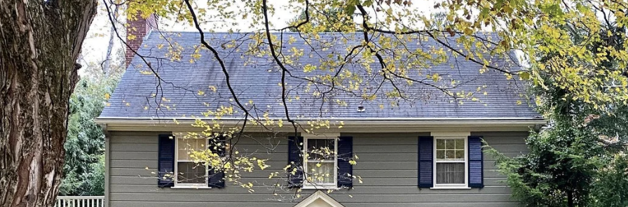
HOME IMPROVEMENT PROGRAM
2024 to 2026 Review - 47 Foxcroft Lane, West Hartford
Maintained by Justin Rivera

Slide 2
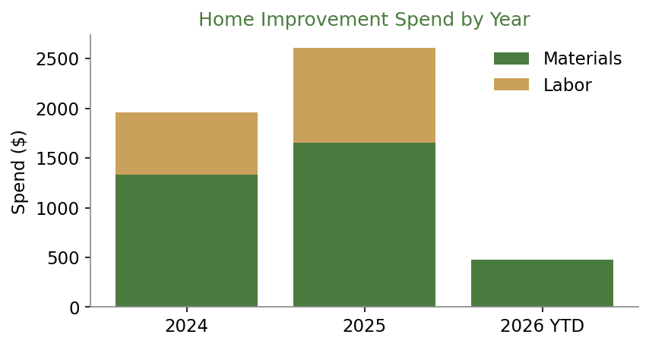
COMPLETED PROJECTS
Two years of upkeep and upgrades
Project | Completed | Materials | Labor | Total
Kitchen backsplash | 2024 | $680 | $450 | $1,130
Basement ceiling insulation | 2024 | $520 | $0 | $520
Garage pegboard tool wall | 2025 | $210 | $0 | $210
Front walkway pavers | 2025 | $890 | $600 | $1,490
Attic insulation top-up | 2026 | $380 | $0 | $380
Home Improvement Program | 2024 to 2026

Slide 3
PLANNED NEXT
Where the budget goes next
• Batting cage rebuild: reset center post in concrete, new netting (about $210).
• Level the pitcher-side ground with compacted fill before spring.
• Driveway resealing follow-up after this winter.
• Evaluate gutter guard performance through one full leaf season.
• Keep single-project spend under the $200 threshold without prior review.
Two-year totals: Materials $3,675 | Labor $1,575 | Combined $5,250
Home Improvement Program | 2024 to 2026

